Slide 1
Setup and Timing
Setup:
MakeCode Adafruit app launched and on Home Page
Each person has a Circuit Playground Express base kit
Shoelaces and wristbands on the table
Timing (45):
Intro (5)
Getting Started with MakeCode (5)
Power Glove Project – Coding (20)
Power Glove Project – Making (10)
Close (5)

Slide 2
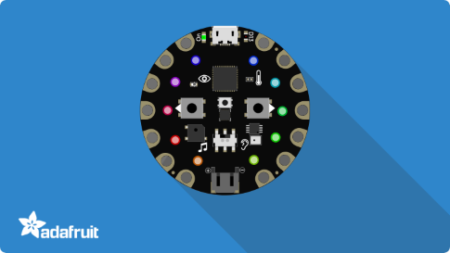
Microsoft MakeCode for Circuit Playground Express
Student Zone – Build It
Notes:
Introduce speaker/helper – Name, What you do at Microsoft, What you studied in School
These are beginner level labs.
There is a big diversity of experience here, and we don’t want to leave anyone behind.
If you are more advanced – please help others, code in JavaScript (we’ll be running these labs in Blocks), and feel free to add more complexity and experiment with your projects
There is also a DIY area available if you want to continue working on your projects and programs after this lab

Slide 3
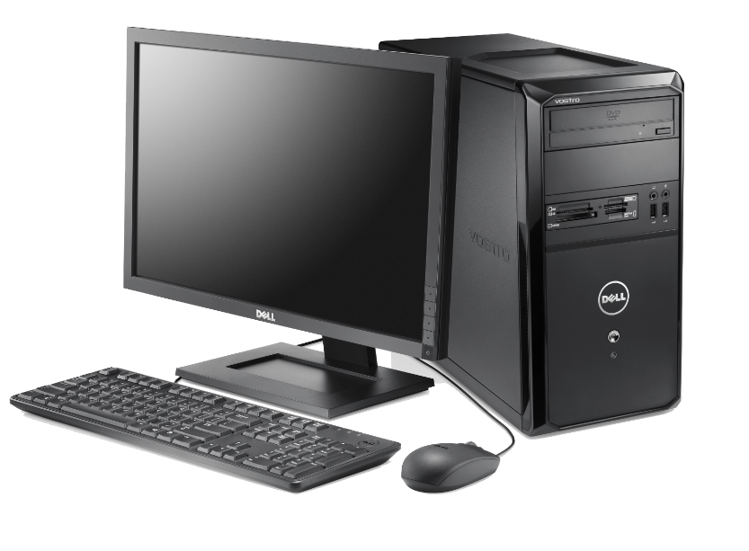
What is computer Hardware?
Central Processing Unit (CPU, “chip”)
Memory
RAM
Storage (“hard drive”)
Inputs
Outputs
Notes:
First, let’s start off talking about Computer Hardware
Who can give me a definition of Hardware?
Physical components of a computer (stuff you can touch/feel)
There are 4 main parts to a computer – no matter what type of computer, all computers have these 4 components
Can anyone guess what they are?
CPU – the brain of the computer, how it processes and transforms information, you may have also referred to it as a “computer chip”
Memory – short-term memory on a computer is called Random Access Memory or RAM (goes away after a while, or when you turn off the computer), long-term memory is called Storage or “Hard Drive” of a computer
Inputs – how a computer takes in information from the world. What are some examples? Keyboard, mouse, touch screen, microphone
Outputs – how a computer displays information. Examples? Monitor/screen, speakers, printer

Slide 4

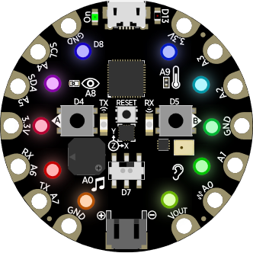
ARM Cortex M0 Microcontroller (32K RAM, 256K Flash )
USB Port
A and B buttons
Infrared receiver, transmitter
Temperature sensor
Light sensor
Motion sensor
Reset button
Microphone
Speaker
14 connector pins
Slide switch
Battery connection
10 neopixel lights
Notes:
Everyone please take out your Circuit Playground Express board from your kit
This is called a micro-controller board, but you can think of it as a baby computer – it has all 4 hardware components that make up a computer
Let’s take a look at what’s on here…
Prompt for:
CPU, Memory
Inputs
Outputs
The Circuit Playground Express is made by a company called Adafruit – they sell these kits for $30, and they also sell lots of accessories and other electronics products

Slide 5
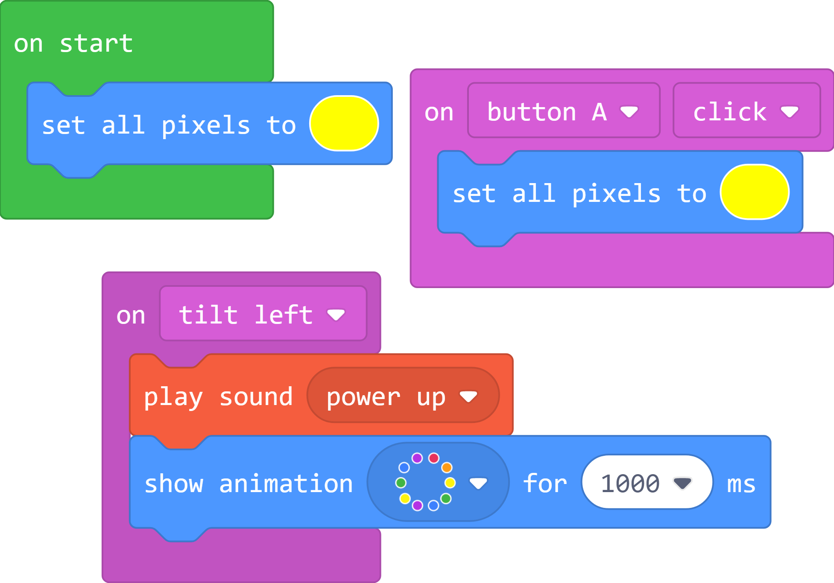
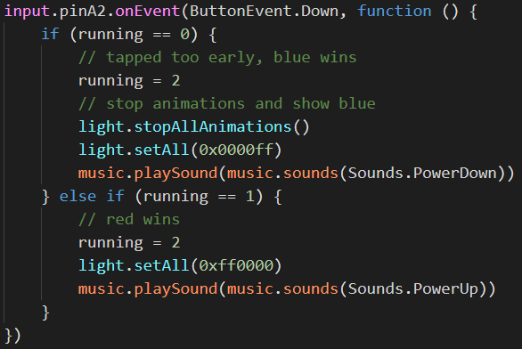
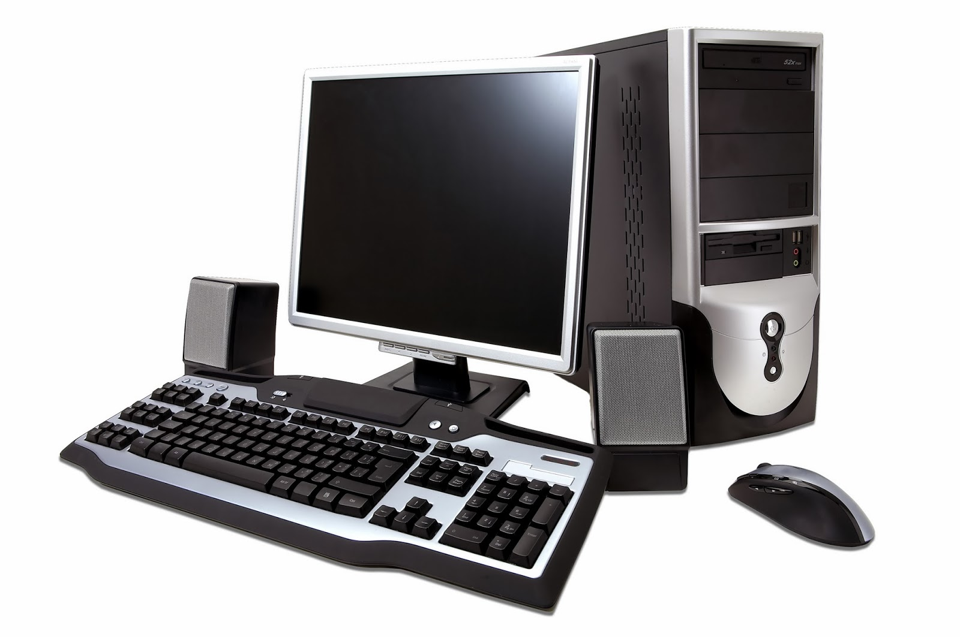

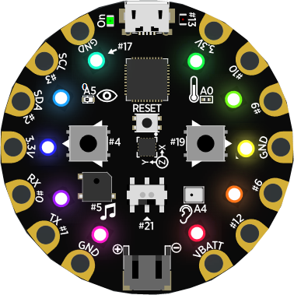
What is computer “Software”?
Hardware
Software
Physical components of a computer system
Instructions or Commands
that tell the computer what to do
Notes:
Now that we’ve talked about Computer Hardware, who can tell me what Computer Software is? Or what it does?
Software is nothing more that a set of instructions or commands that tell a computer what to do
We write software (or programs or code) that run on hardware

Slide 6
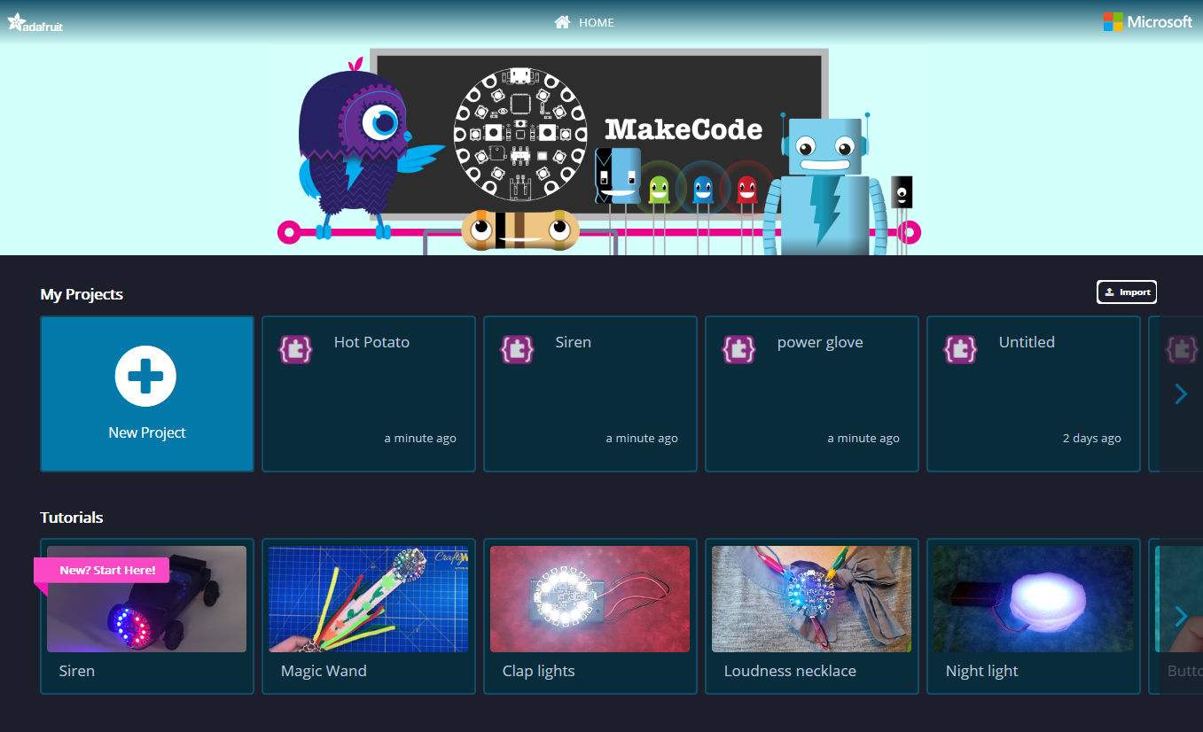
MakeCode for Circuit Playground Express
Notes:
Open up the MakeCode Adafruit app on your computer
You should see a Home Screen like this
There are step-by-step tutorials, projects and code samples available from this page
On this Home page, you can also see a list of your recent projects and you can import existing programs via a shared URL or file
Go ahead and click to create a New Project

Slide 7
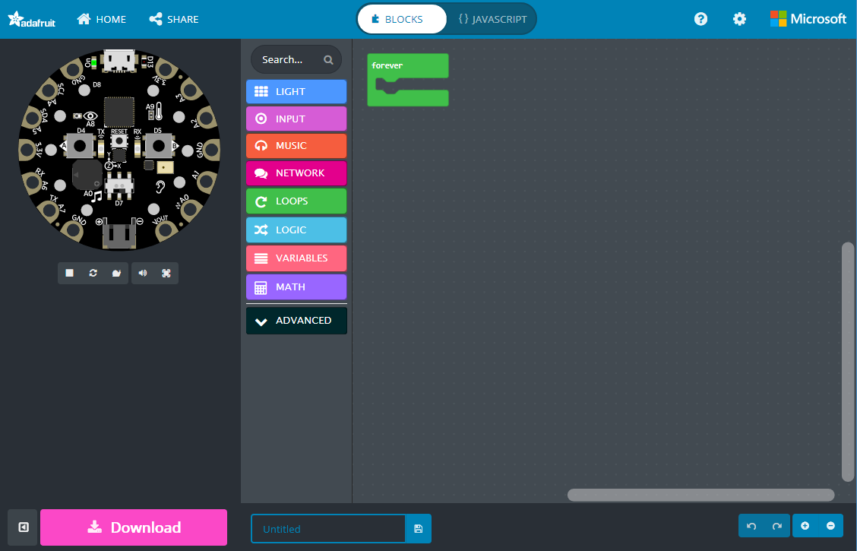
Go back to Home screen
Get a URL to share your project
Switch between Blocks and JavaScript
Simulator shows what your program will look like running on the board
Programming Workspace where you will build your program
Block Toolbox
Download your program to the Circuit Playground Express
Name your Project and Save it on your computer
Notes:
This is the MakeCode editor
On the left side of the screen you’ll see something that looks like a Circuit Playground Express – this is an interactive Simulator and will show you what your code will look like. It’s good for testing and debugging your code.
In the middle is the Block Toolbox – which contains different categories of blocks that you can use in your program
On the right side is the Programming Workspace – where we’ll be building our program

Slide 8
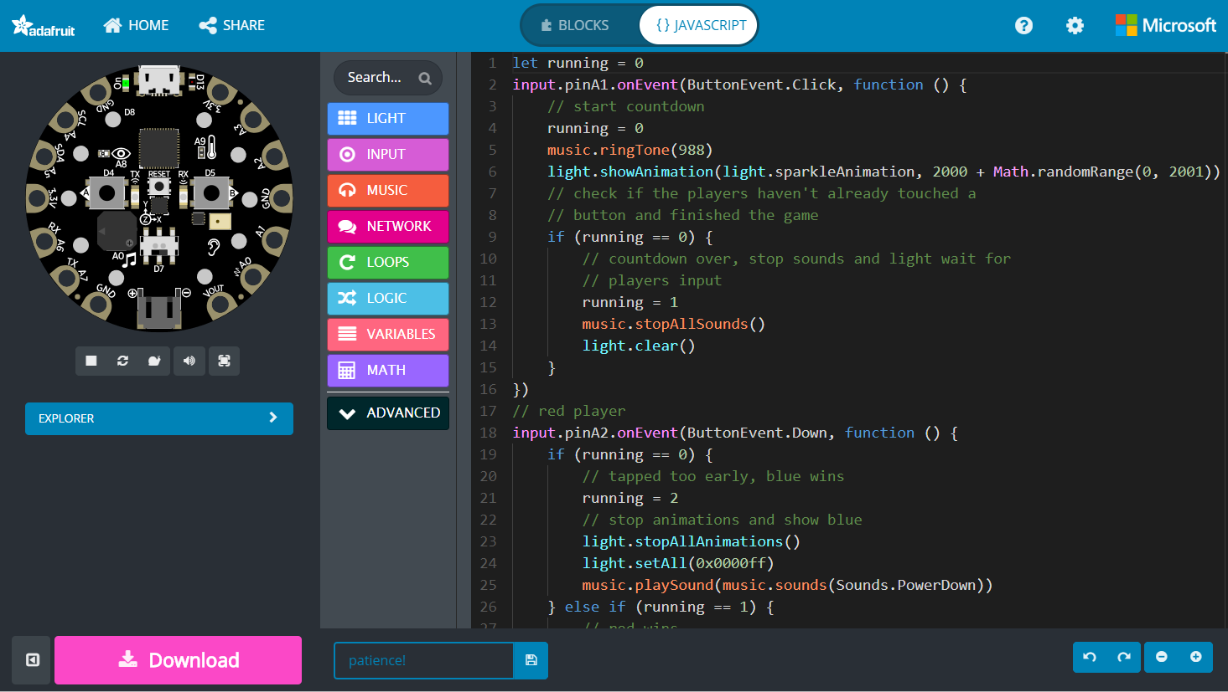
Notes:
Using the Toggle button on the top, you can switch into the JavaScript editor
More advanced students should feel free to program in JavaScript – there is intellisense, code completion and error detection to help you.
You can also use the Toolbox to drag out code snippets into the programming workspace.

Slide 9
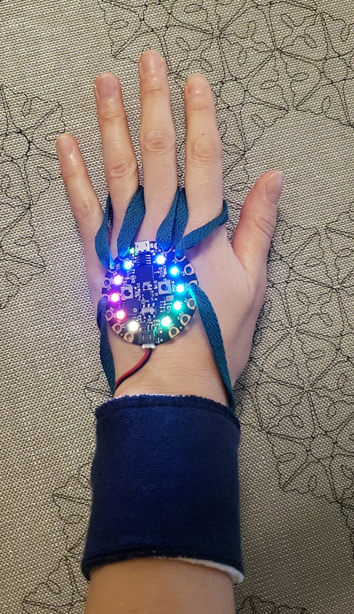
Power Glove Project
Notes:
Okay, let’s start our project!
We’re going to be creating a Power Glove project
[ Demo the Power Glove ]

Slide 10
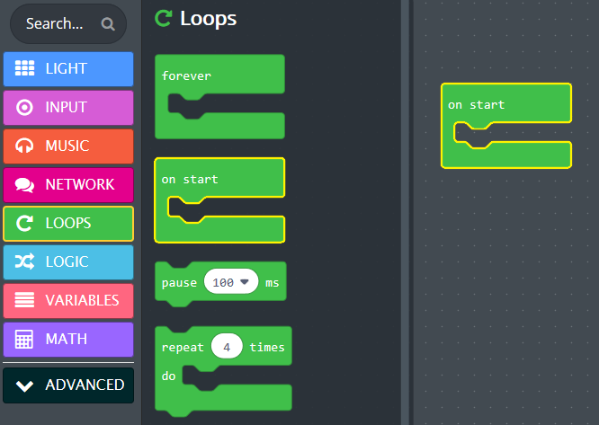
Starting your program
Open the Loops Toolbox drawer
Drag an On Start block onto the Workspace

Slide 11
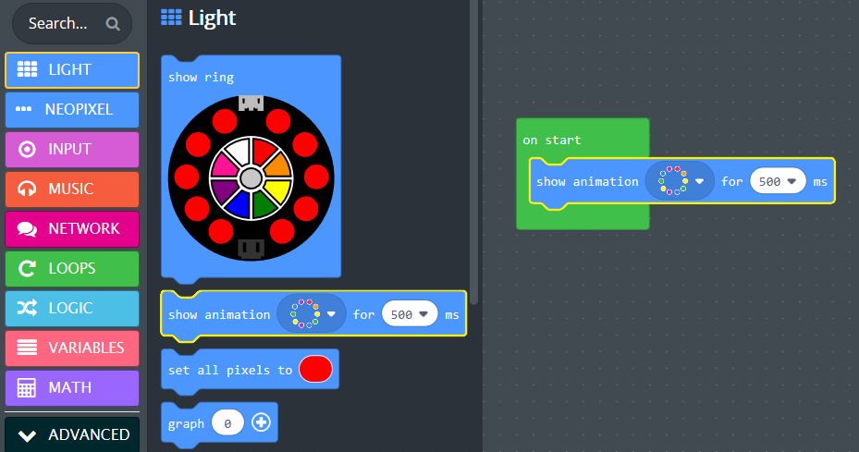
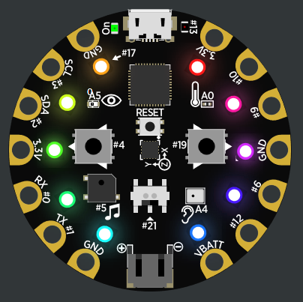
Built-in Animations
Open the Light Toolbox drawer
Drag a Show Animation block under the On Start block
Change duration to 2 seconds
Notice your animation running in the Simulator
Try experimenting with different animations

Slide 12
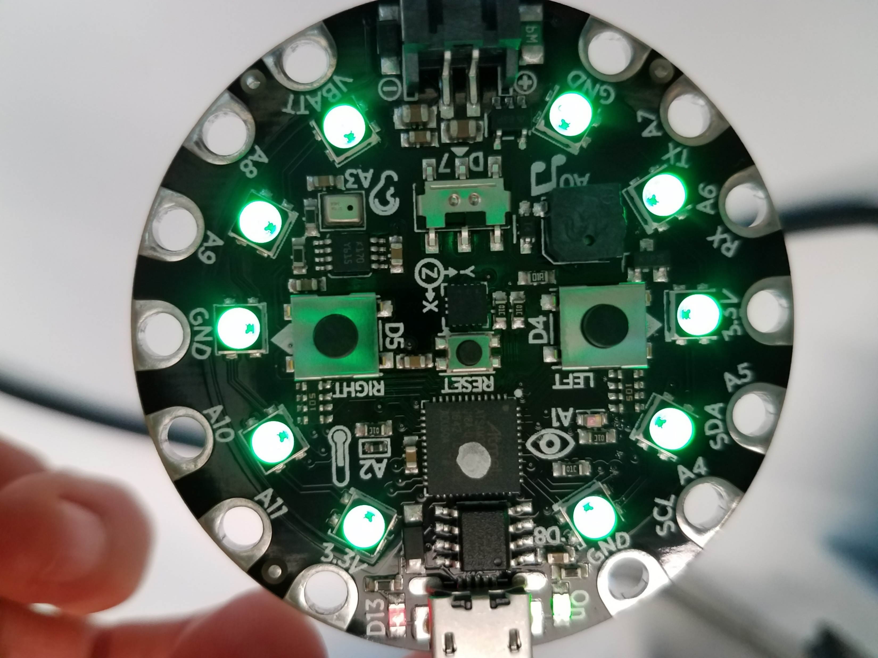
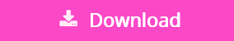
Download your program to Circuit Playground Express
Plug in your Circuit Playground Express to the computer via the USB cable
1st Time – Press and Release the
Reset button on the board
Click Download Button
Lights should turn green

Slide 13
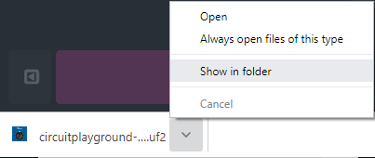
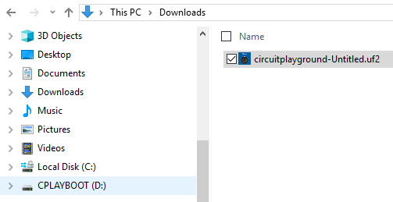
Download your program to the Circuit Playground
Plug in your Circuit Playground Express with USB cable
Press and Release the Reset button on the board until all the lights turn Green
Click Download Button
Edge: Click Save As
Chrome: Select Show in folder
Copy your file over to the micro:bit USB drive

Slide 14
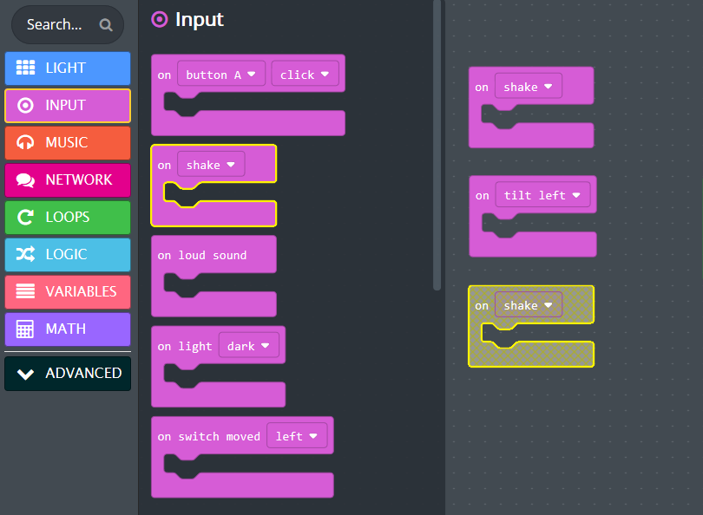
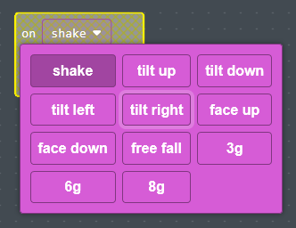
Using Inputs
Open the Input Toolbox drawer
Drag three On Shake blocks onto the Workspace
Using the drop-down menus, change two blocks to Tilt Left and Tilt Right

Slide 15
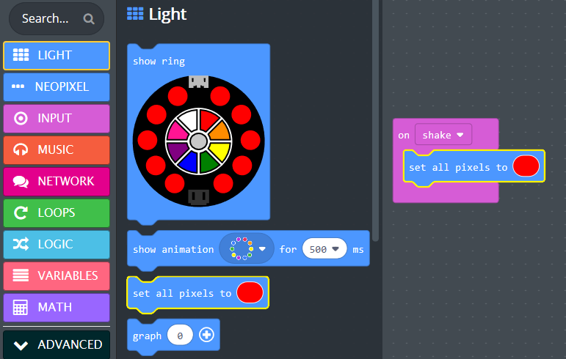
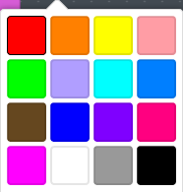
Turn on Lights when you Shake it
Open the Light Toolbox drawer
Drag a Set All Pixels block under the On Shake block
Pick a color

Slide 16
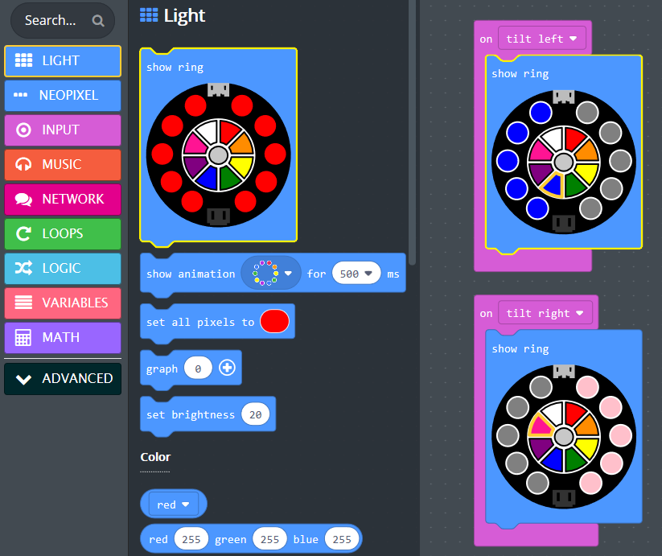
Turn on Lights when you Tilt it
Grey = Lights off
Open the Light Toolbox drawer
Drag two Show Ring blocks under each of the On Tilt blocks
Click on the color picker wheel to select a color for the right and left side

Slide 17
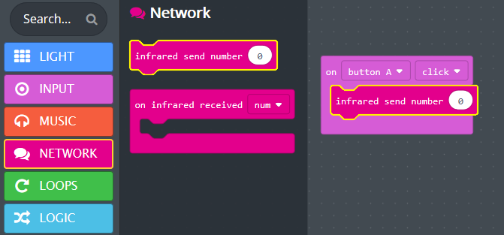
Laser Tag with Infrared
Open the Input Toolbox drawer
Drag an On Button Pressed block onto the Workspace
Open the Network Toolbox drawer
Drag an Infrared Send Number block into the
On Button Pressed block

Slide 18
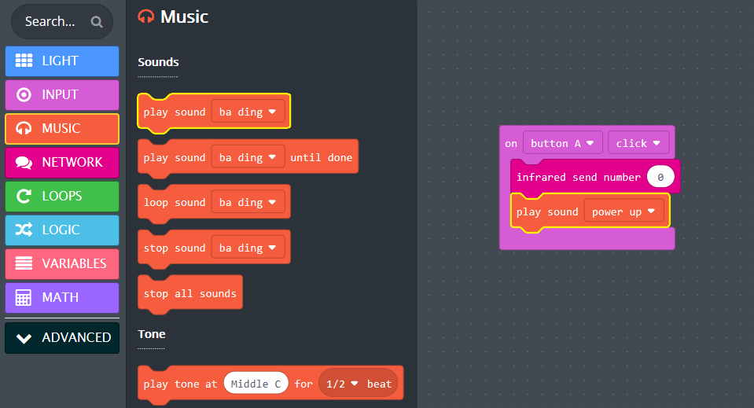
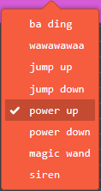
Add Music
Open the Music Toolbox drawer
Drag a Play Sound block after the Infrared Send Number block
Pick a sound to play

Slide 19
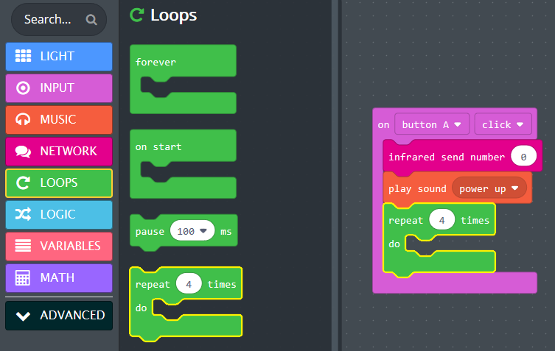
Blink Lights
Open the Loops Toolbox drawer
Drag a Repeat block after the Play Sound block

Slide 20
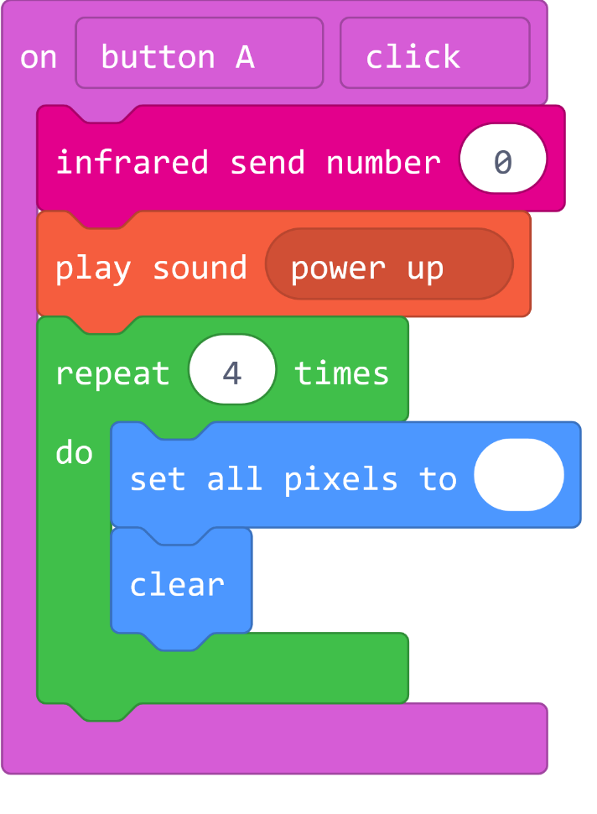
Blink Lights
Open the Light Toolbox drawer
Drag a Set all Pixels block inside the Repeat loop
Change to White light
Drag a Clear block after the Set all Pixels block

Slide 21
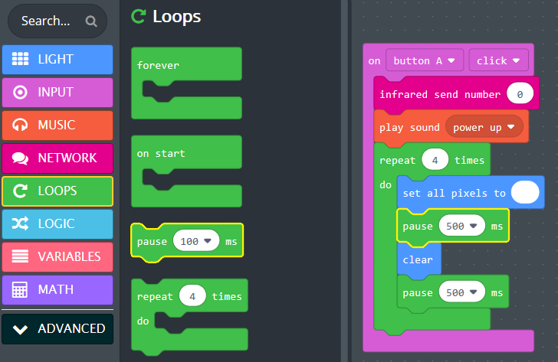
Blink Lights
Open the Loops Toolbox drawer
Drag out two Pause blocks
Place one each after Set all Pixels and Clear blocks
Set duration to 500 milliseconds

Slide 22
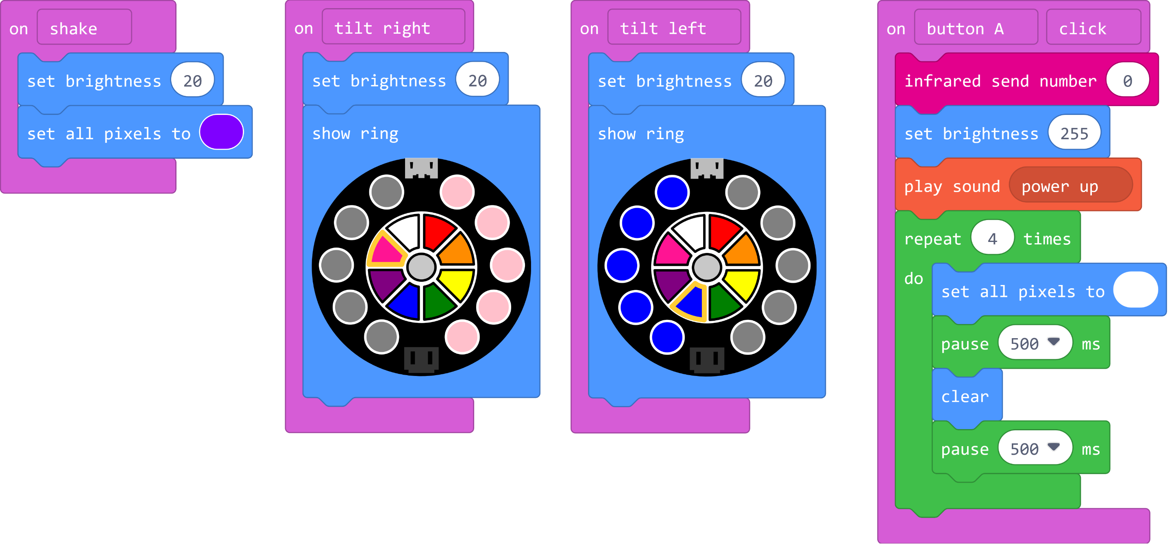
Set Brightness
From the Light Toolbox drawer, drag out four Set Brightness blocks
Drop one each into:
On Shake
On Tilt Left
On Tilt Right
On Button Click –
Drop after the
Infrared Send Number block
and change the value to 255

Slide 23
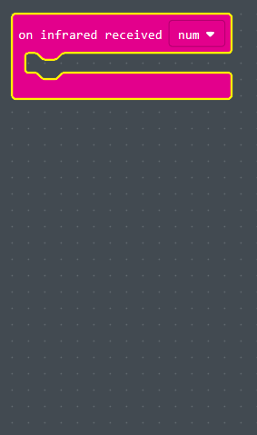
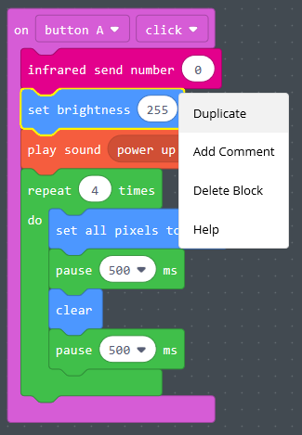
Receive IR message
Open the Network Toolbox drawer
Drag out a On Infrared Received block onto the Workspace
Right-click on the Set Brightness block in the On Button Press and select Duplicate
Drag copied blocks over into the On Infrared Received block

Slide 24
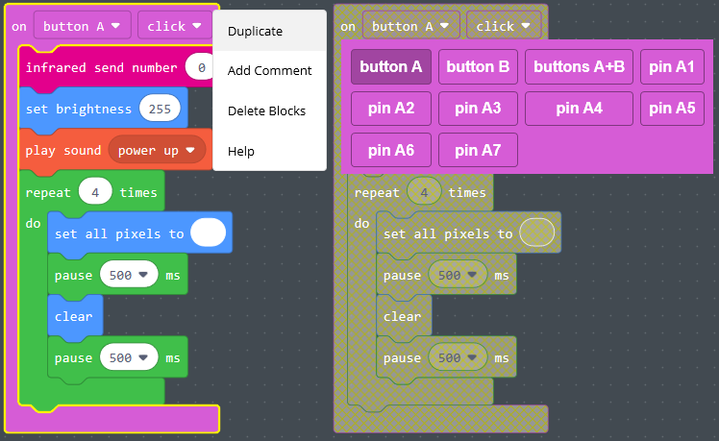
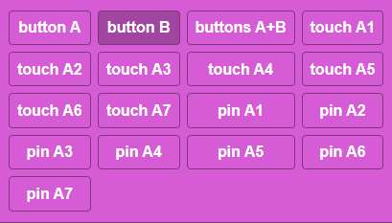
Duplicate for Button B
Right-click on the On Button Press block and select Duplicate
Use the drop-down menu to select Button B

Slide 25
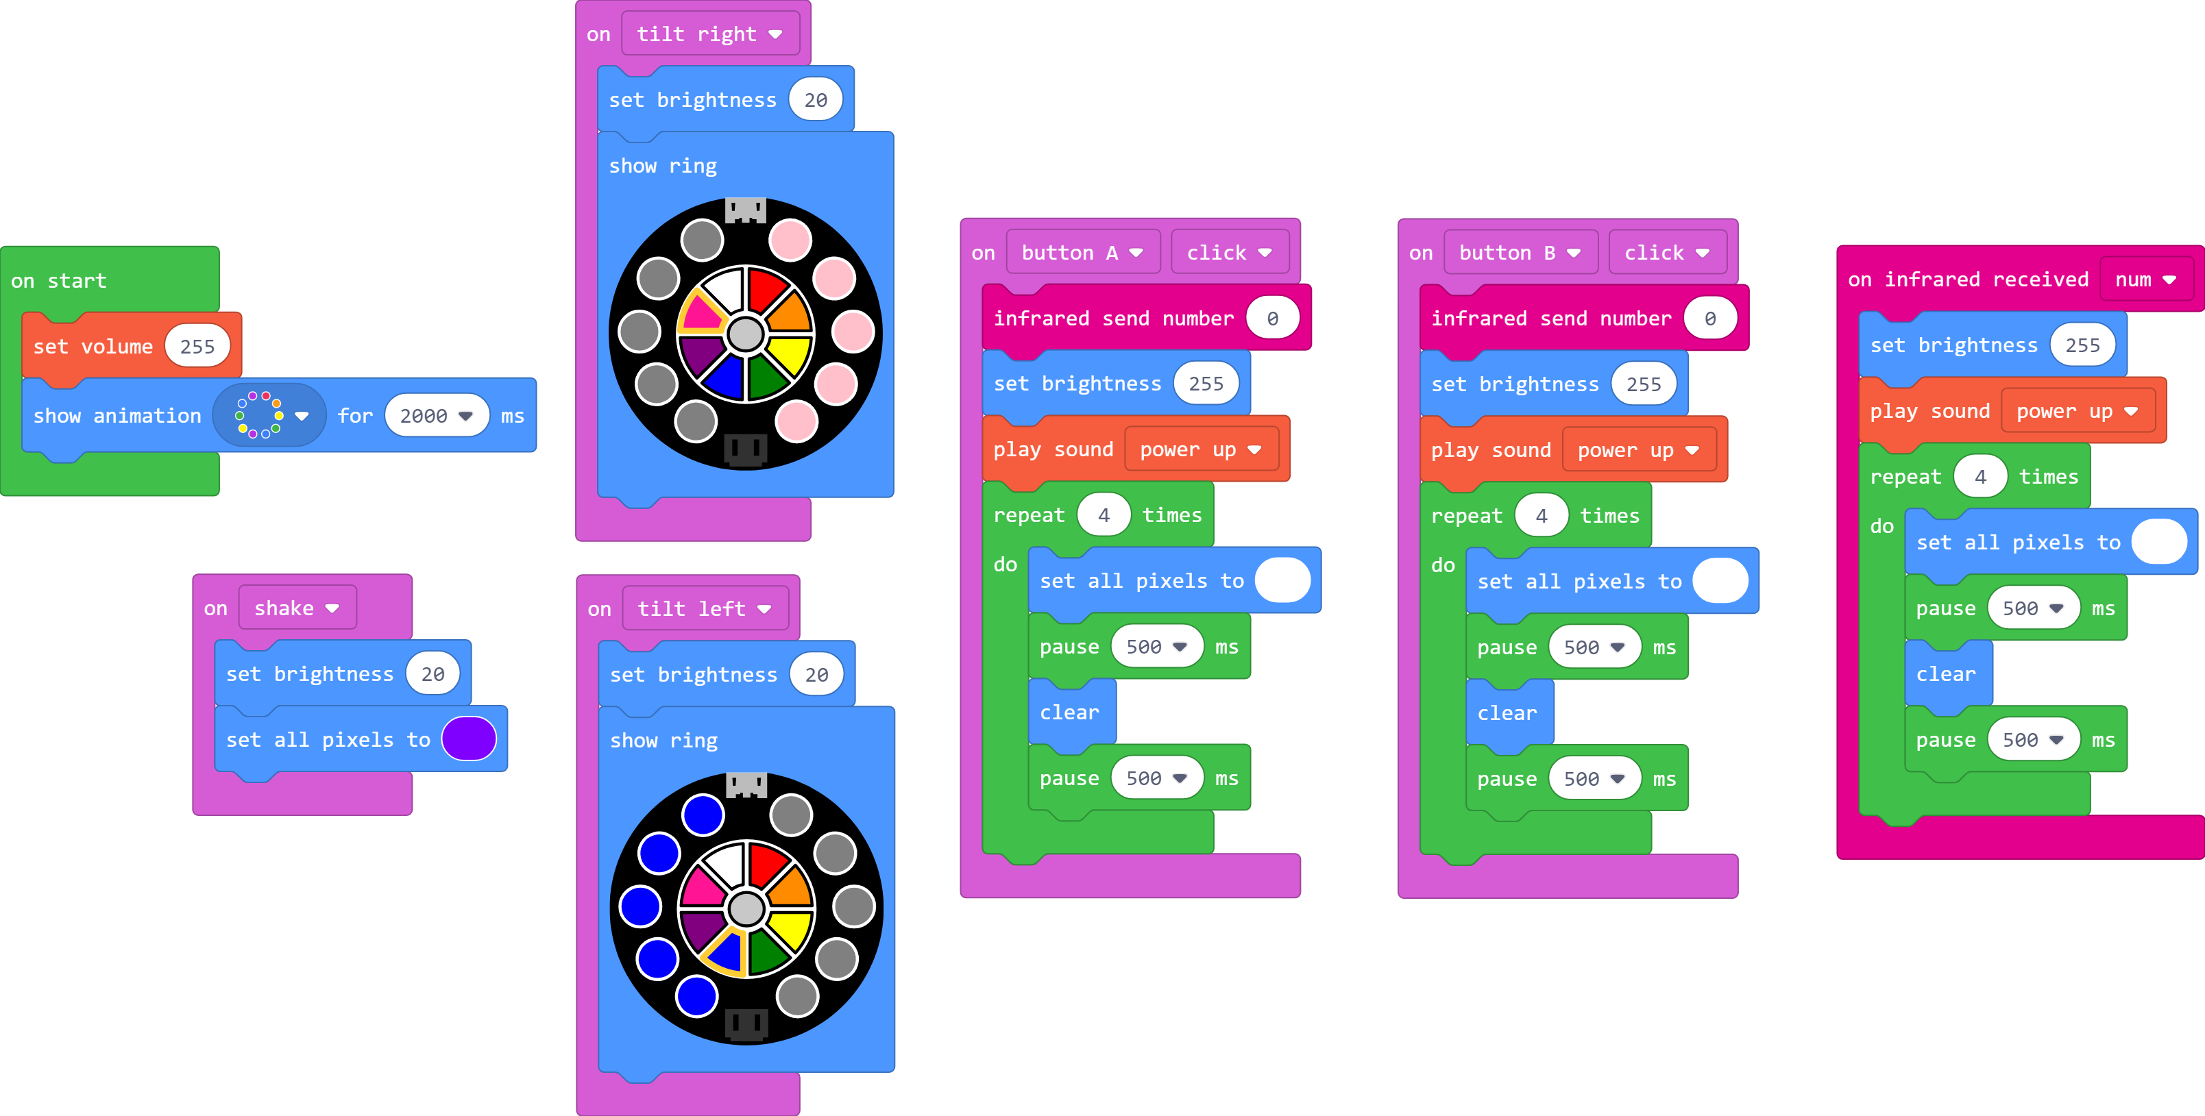
Complete Code

Slide 26
Download your program to Circuit Playground Express
Plug in your Circuit Playground Express to the computer via the USB cable
1st Time – Press and Release the
Reset button on the board
Click Download Button
Lights should turn green

Slide 27
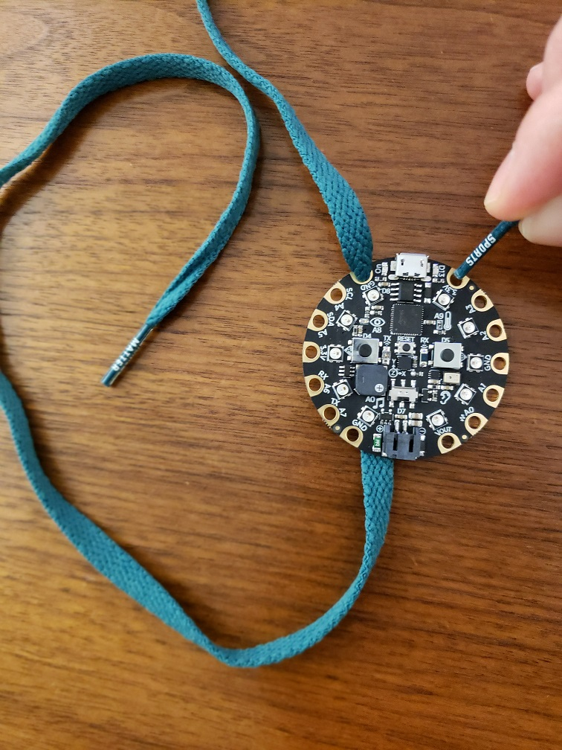
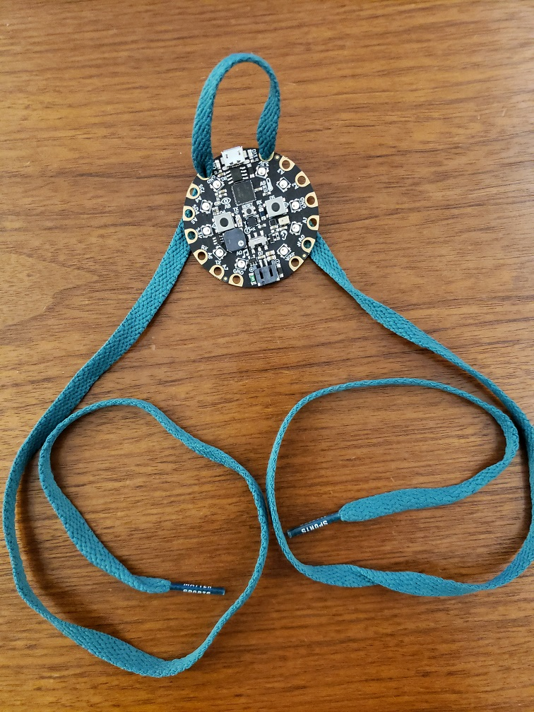
Making the Power Glove
Unplug your Circuit Playground Express from the computer
Pick a shoelace and wristband
Thread the shoelace evenly through the top CPX connectors

Slide 28
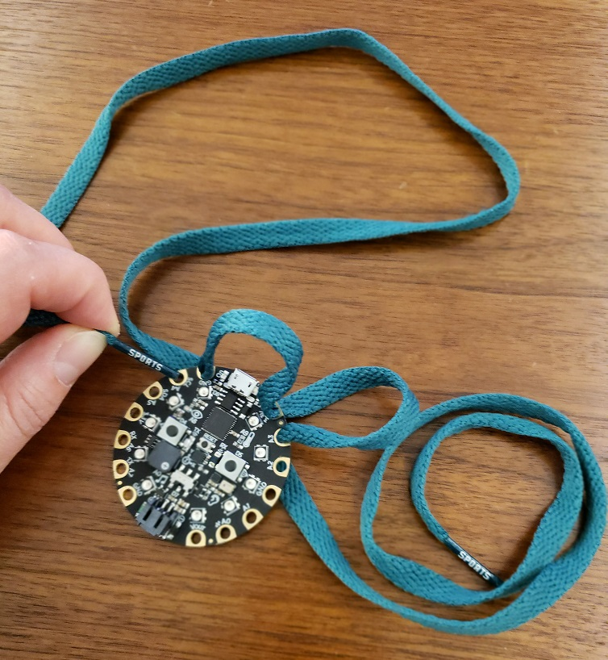
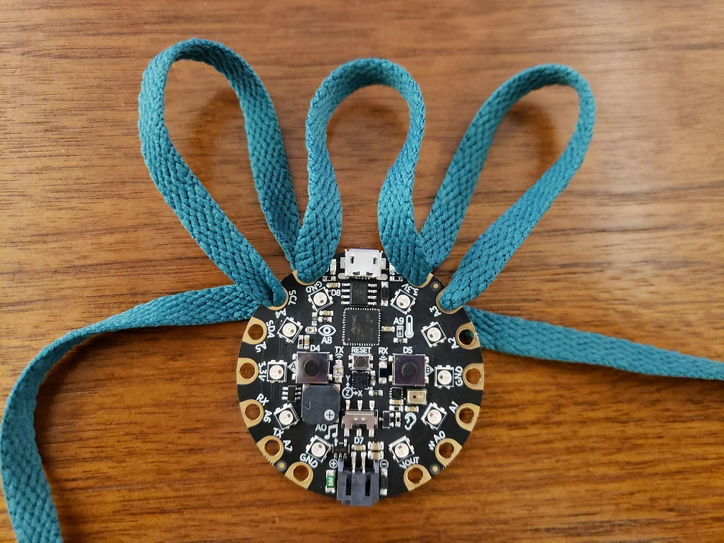
Threading the finger holes
Make 2 more loops for pointer finger, and ring finger

Slide 29
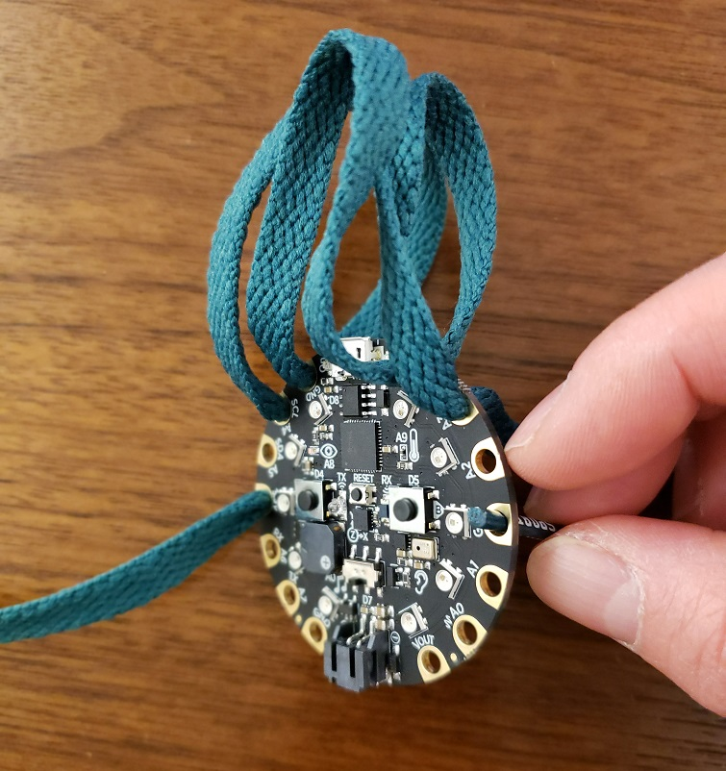
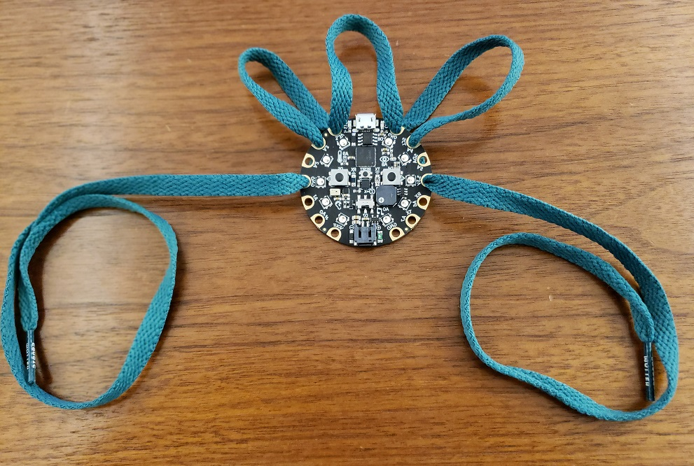
Thread through the side holes

Slide 30
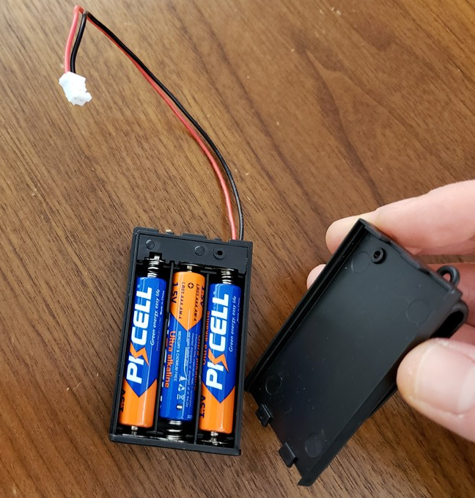
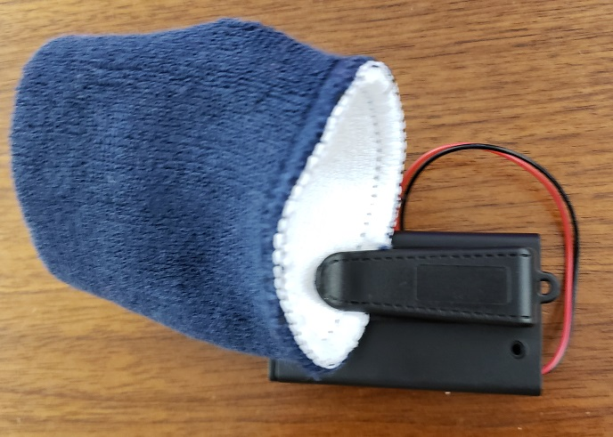
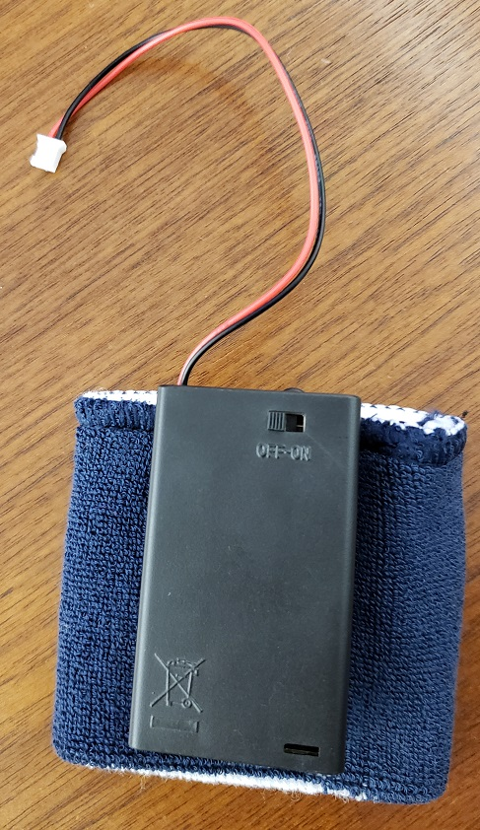
Attach battery pack to wristband
Put batteries in battery pack
Use the battery pack clip to attach to wrist band

Slide 31
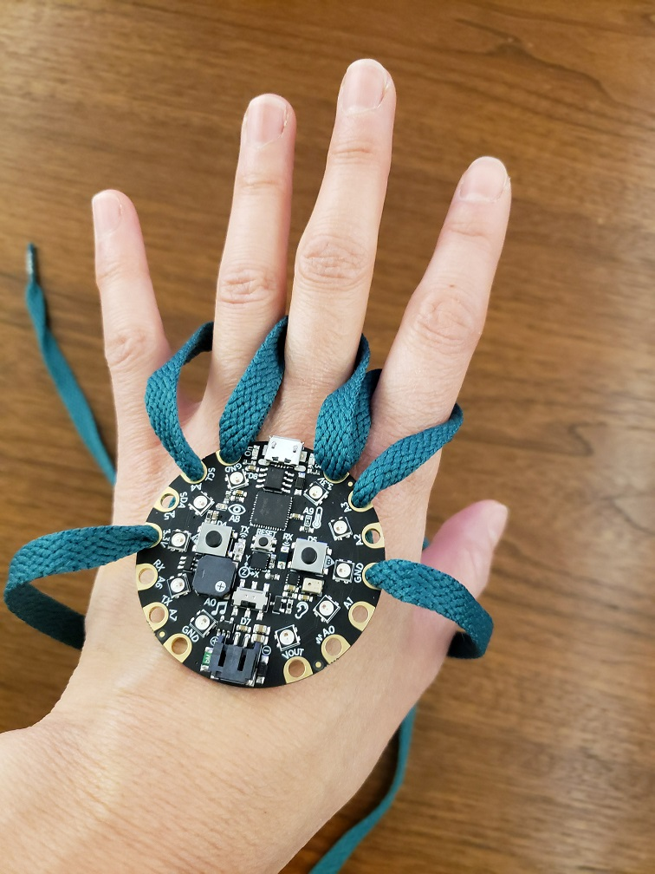
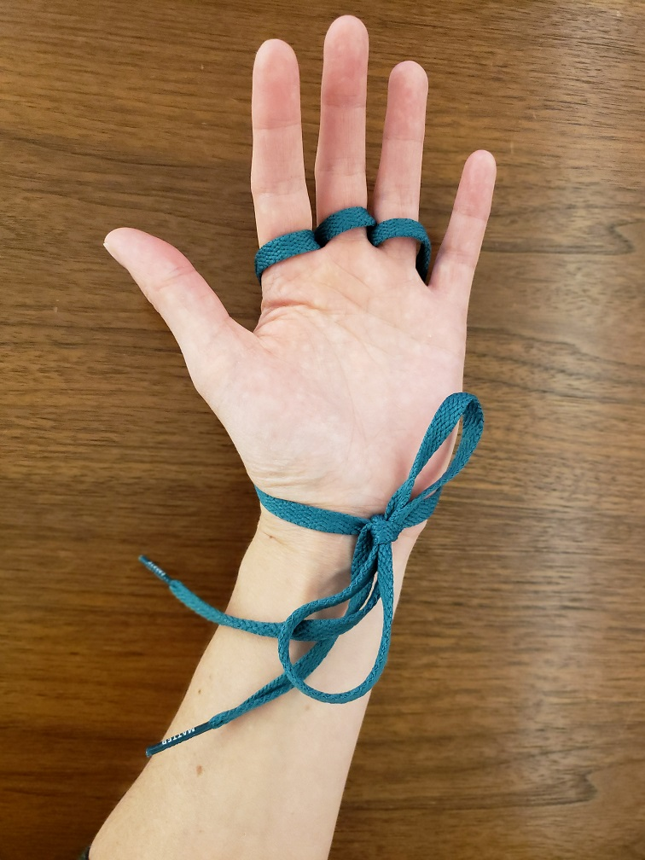
Mount to hand
Put 3 fingers through the loops
Have a friend help tie shoelaces at your wrist

Slide 32
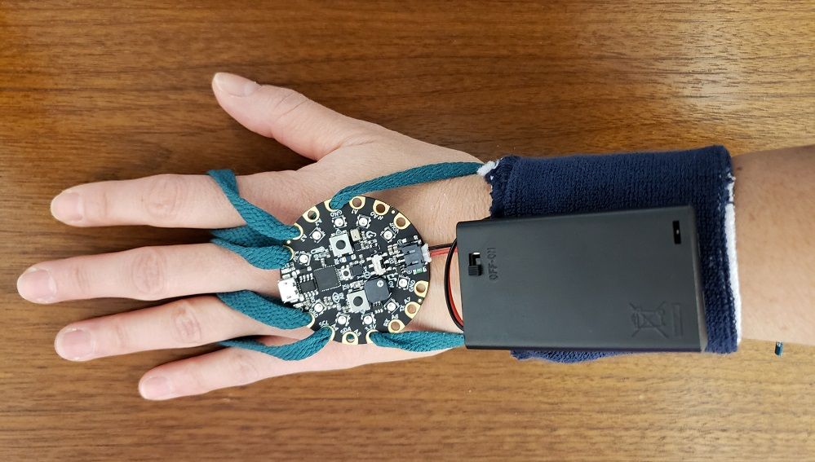
Attach Batteries
Put on wristband and battery pack
Insert battery cable into Circuit Playground Express

Slide 33
Test your Power Glove
Turn on batteries
Check start-up animation
Check Shake, Tilt Left/Right
Press buttons to shoot

Slide 34
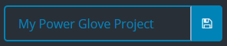


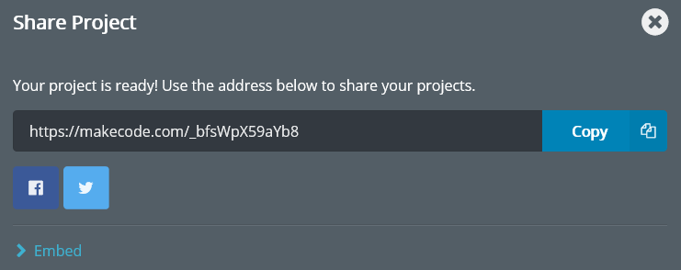
Share your Code
Give your program a name
Click the Share button in the top left
Click the Publish Project button
Copy the URL somewhere (or take a picture)

Slide 35
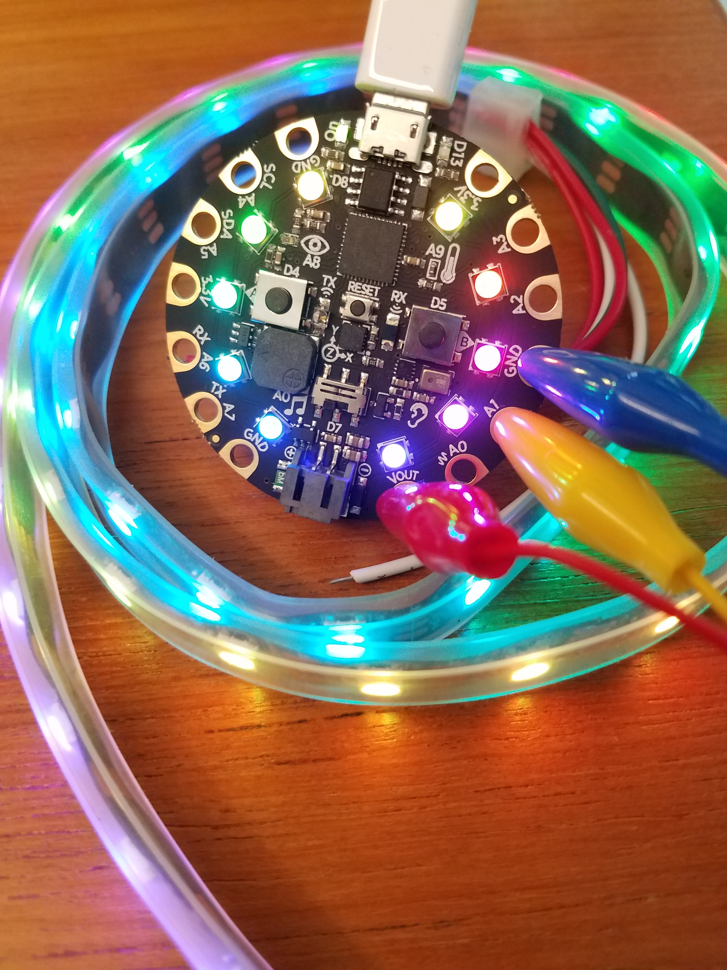
Extension Ideas
Put the Power Glove on your palm and use the G-force of your hand to activate the Infrared
Attach a NeoPixel strip and graph Accelerometer values
Compose your own songs using the Play Tone blocks
Attach servo motors and make a Robot
Use the Light Photon blocks to draw your own custom animations
Notes:
Here are a few more ideas for coding with your Circuit Playground Express
Feel free to explore more at the DIY area where we have additional accessories for your Circuit Playground Express kits – including NeoPixel Strips, Servo Motors and more

Slide 36

Microsoft MakeCode for Circuit Playground Express
Please fill out Survey! – aka.ms/SurveyCP
More about MakeCode – makecode.com
More about Circuit Playground Express –adafruit.com/circuitplaygroundexpress
Notes:
Any last questions before we wrap up?
Here are some links for where you can continue coding using the MakeCode web editors at home, and where you can get more information about Circuit Playground Express
Thanks so much for attending and go forth and use your Power Glove for good!

